Slide 1


CS Bridge

Slide 2
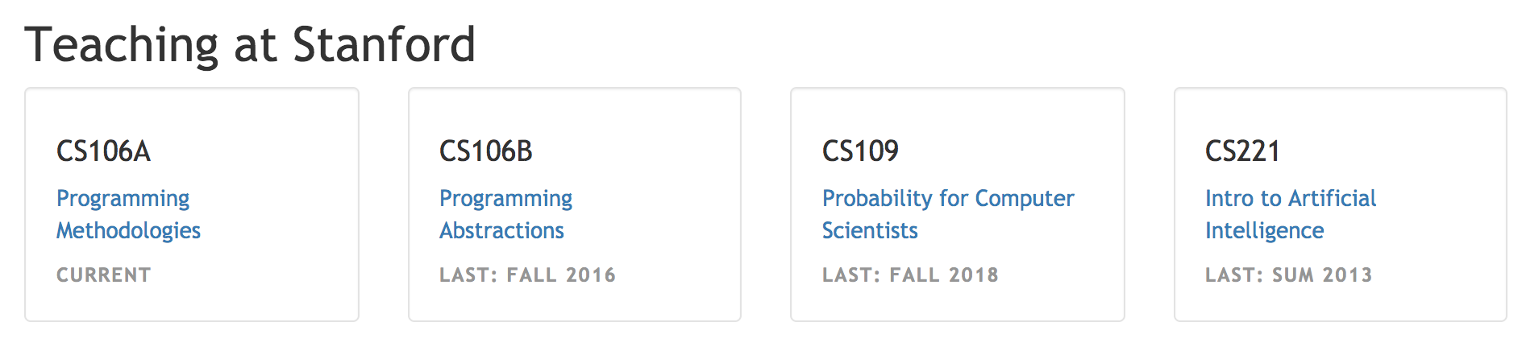

Slide 3
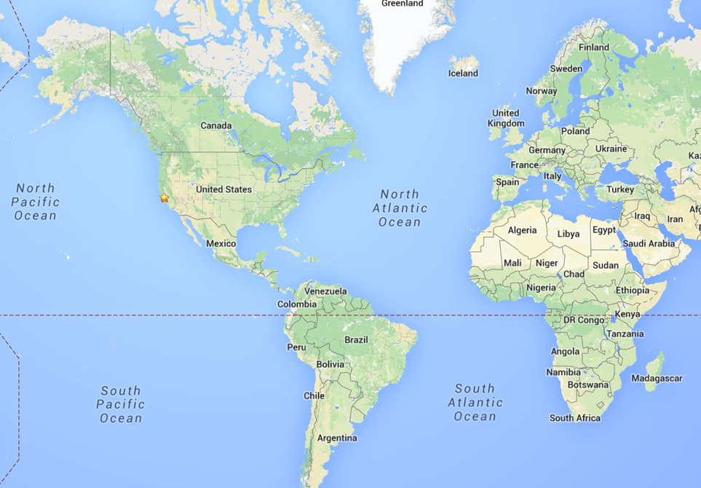
Stanford?
Notes:
Call me Chris
I grew up in a bunch of places.
I’m a PhD in Artificial Intelligence
Everyone once in a while they let me teach, even though I’m young.
Mostly because I get so excited.
Actually I got my first chance to teach because of the facebook like button… but that’s a story for another day.

Slide 4
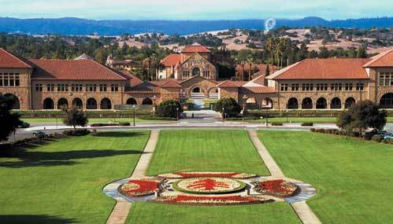
Stanford

Slide 5
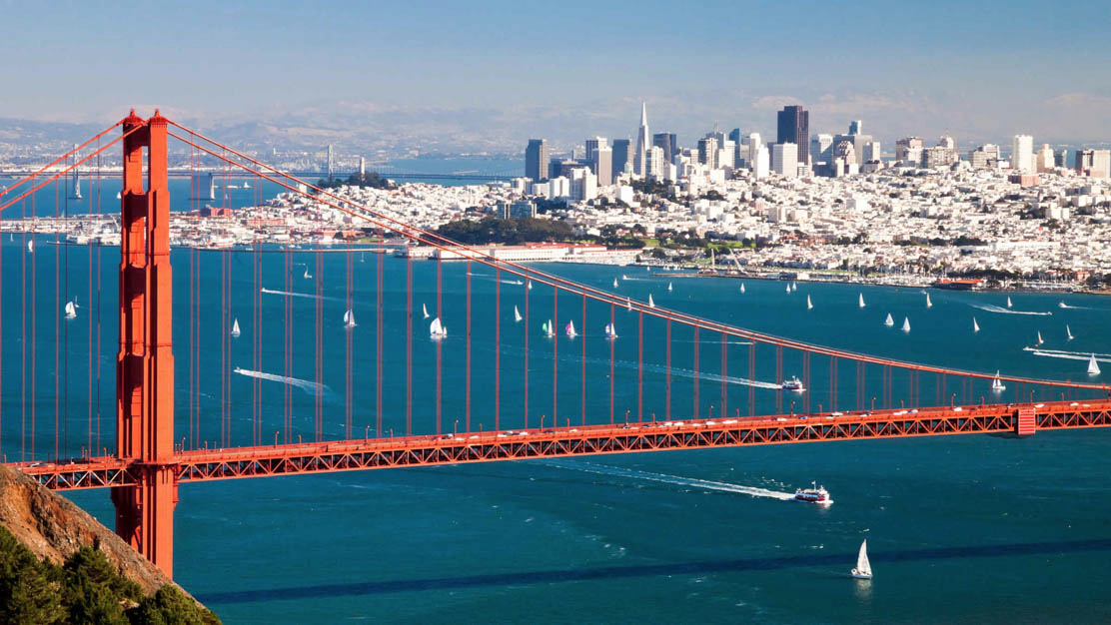
Near San Francisco

Slide 6
Kenya
Notes:
We want all of you to be successful
That’s why we have such a large course staff
And its not like it’s a ya-ya course where we all hold hands and sing koombaya. Its real material.
But over years and years and years we have been working on our material so that everyone gets through…
Your going to get your moneys worth… but as I understand it this course is free so hopefully you get more than your money’s worth ☺
Not competing against anyone but yourself

Slide 7
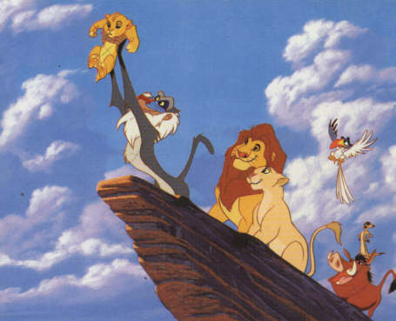
Kenya
Notes:
We want all of you to be successful
That’s why we have such a large course staff
And its not like it’s a ya-ya course where we all hold hands and sing koombaya. Its real material.
But over years and years and years we have been working on our material so that everyone gets through…
Your going to get your moneys worth… but as I understand it this course is free so hopefully you get more than your money’s worth ☺
Not competing against anyone but yourself

Slide 8
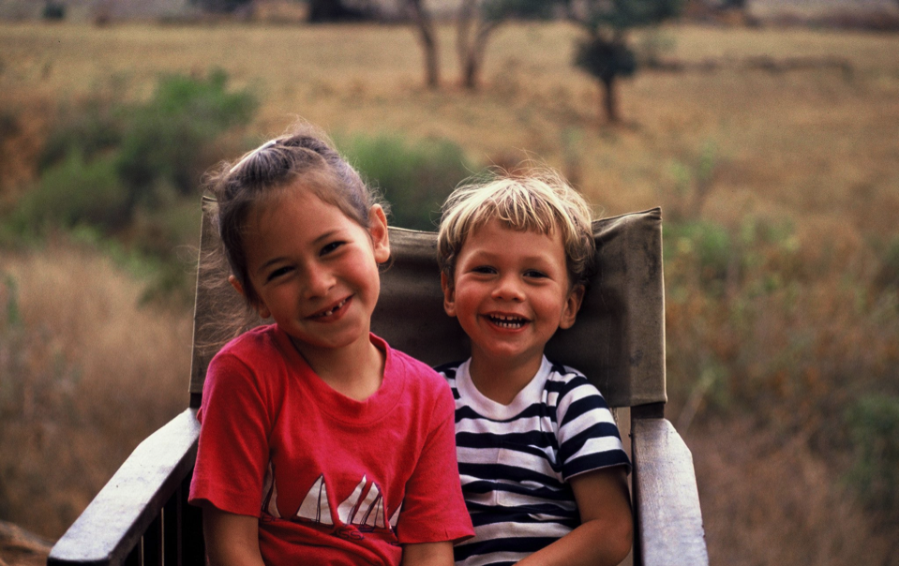
Kenya
Notes:
We want all of you to be successful
That’s why we have such a large course staff
And its not like it’s a ya-ya course where we all hold hands and sing koombaya. Its real material.
But over years and years and years we have been working on our material so that everyone gets through…
Your going to get your moneys worth… but as I understand it this course is free so hopefully you get more than your money’s worth ☺
Not competing against anyone but yourself

Slide 9
Logistics

Slide 10
Course Website
http://ctu.csbridge.org
*note that its org not com

Slide 11
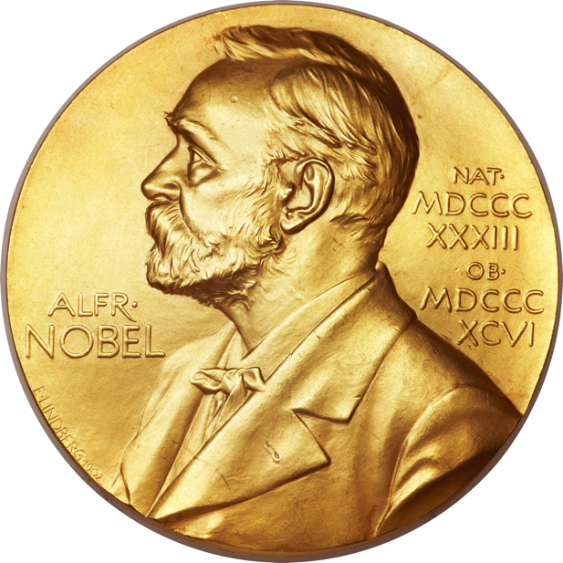
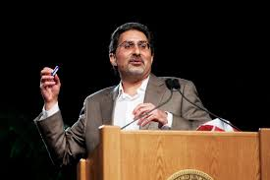
Prize Policy

Slide 12
Are there any questions?

Slide 13
About the class

Slide 14
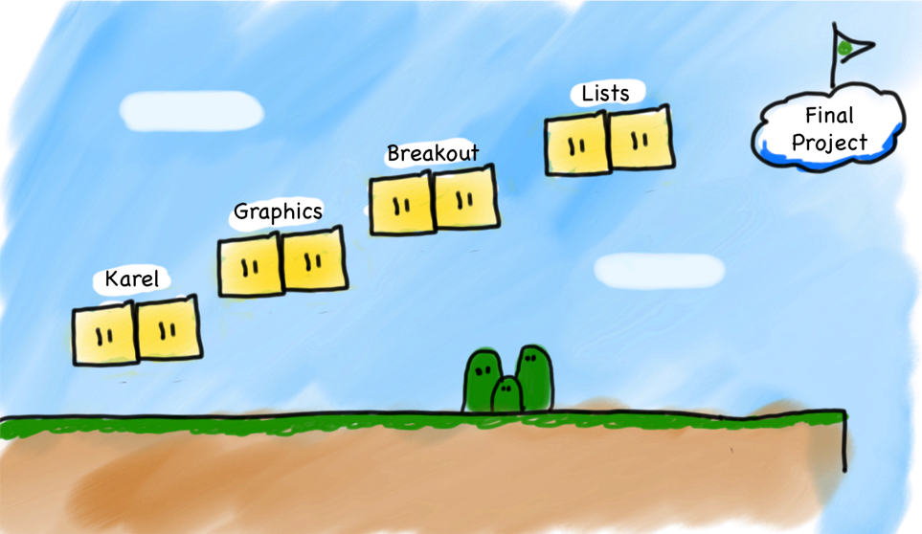
Very High Level

Slide 15
Joint Effort

Slide 16
Great Team
Notes:
700 students
Most students at stanford take the course.
You are going to get the same matrial, and the same respect that we would give to students back home..
And your like… but you are throwing candy and stuff. Yep this is whats its like there too

Slide 17
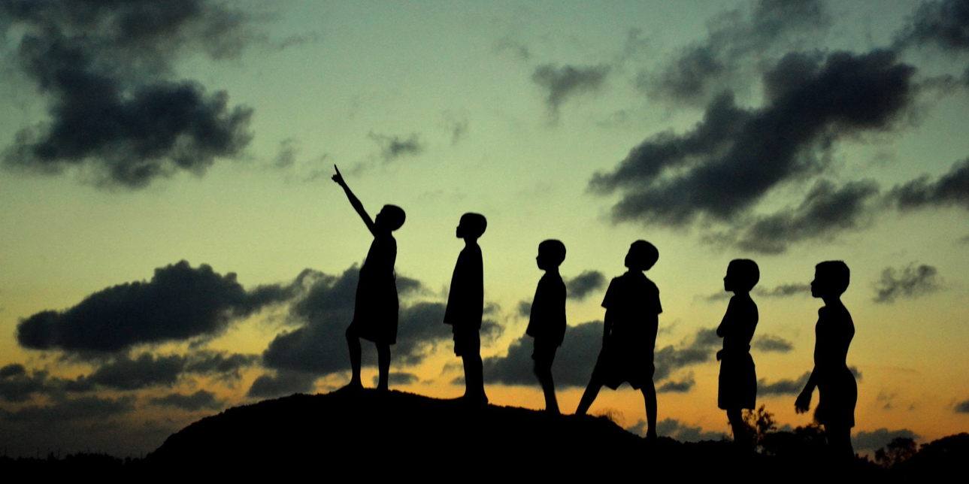
Section Leader
Notes:
700 students
Most students at stanford take the course.
You are going to get the same matrial, and the same respect that we would give to students back home..
And your like… but you are throwing candy and stuff. Yep this is whats its like there too

Slide 18
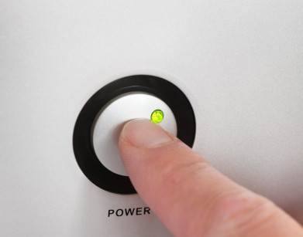
Prerequisites
Notes:
Just need to know how to turn on a computer.
In fact about 8 years ago I was in your seats learning programming.
… and then I did the grad school thing and the teaching thing.
It worked out.

Slide 19
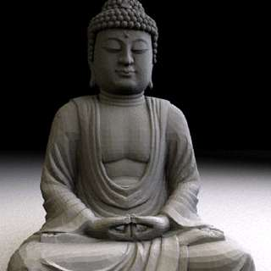
Computer Science
Notes:
We teach software engineering principles. Much larger than just programming.
Mechanics of the language are nothing compared to the principles.
You are going to learn the principles by programming in Java

Slide 20
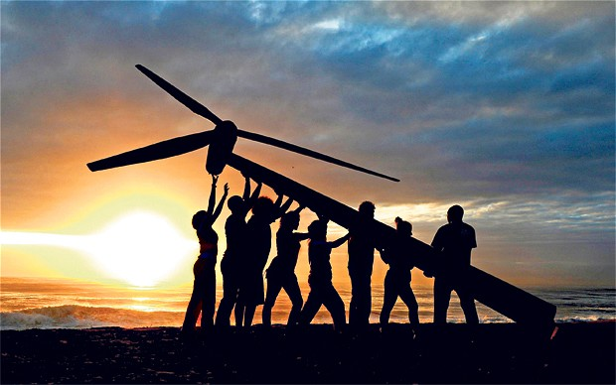
Everyone Succeeds
Notes:
We want all of you to be successful
That’s why we have such a large course staff
And its not like it’s a ya-ya course where we all hold hands and sing koombaya. Its real material.
But over years and years and years we have been working on our material so that everyone gets through…
Your going to get your moneys worth… but as I understand it this course is free so hopefully you get more than your money’s worth ☺
Not competing against anyone but yourself

Slide 21
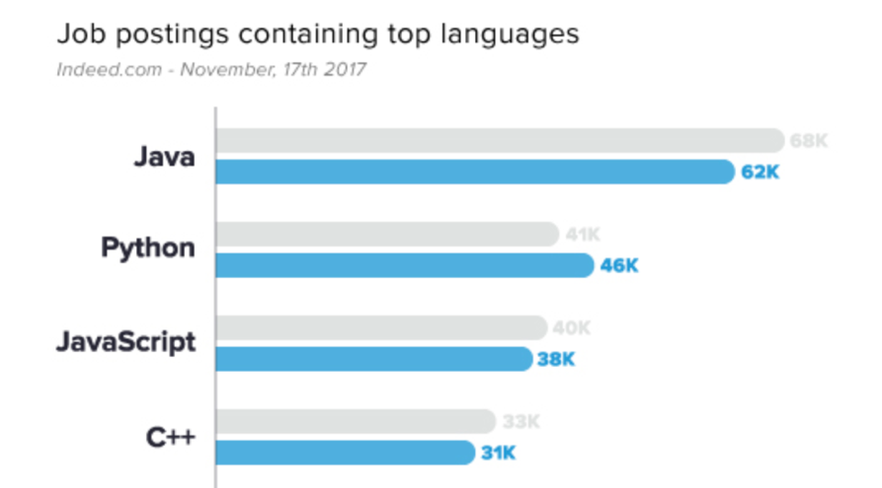
Why Java?
1
2
http://www.codingdojo.com/blog/7-most-in-demand-programming-languages-of-2018/

Slide 22
Breakout
Notes:
We want all of you to be successful
That’s why we have such a large course staff
And its not like it’s a ya-ya course where we all hold hands and sing koombaya. Its real material.
But over years and years and years we have been working on our material so that everyone gets through…
Your going to get your moneys worth… but as I understand it this course is free so hopefully you get more than your money’s worth ☺
Not competing against anyone but yourself

Slide 23
What if I fall behind?

Slide 24
No grades!

Slide 25
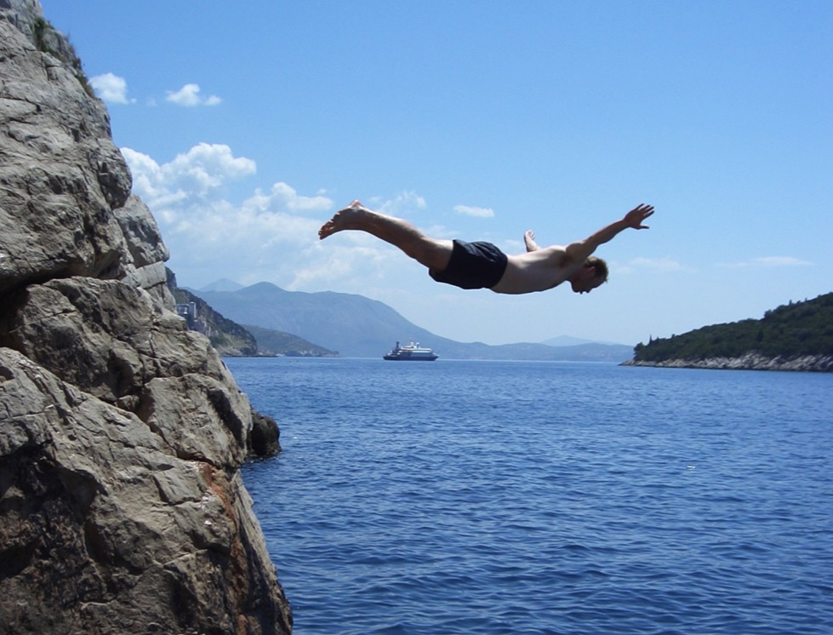
Lets Get Started

Slide 26
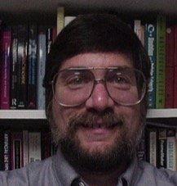
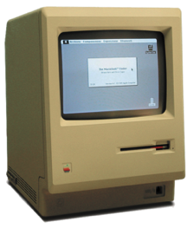

Meet Karel!
Ahoy!
jak se máš?
Karel Čapek
Notes:
He looks like an old machintosh machine.
Hes got legs… one sticks out the back. That’s just the way it is.

Slide 27

Karel Speaks Java
s
Notes:
Tomorrow you will learn that Karel is actually a very gentle introduction to programming

Slide 28


Karel’s World
North
3
+
+
+
+
+
2
+
+
+
+
+
West
East
1
+
+
+
+
+
South
1
2
3
4
5
Notes:
To you it might not be exciting but to karel its very exciting.

Slide 29

Walls
3
+
+
+
+
2
+
+
+
+
1
+
+
+
+
1
2
3
4

Slide 30

Beepers
3
+
+
+
+
2
+
+
+
+
1
+
+
+
+
1
2
3
4

Slide 31
Knows Four Commands
move();
turnLeft();
putBeeper();
pickBeeper();
Notes:
Tomorrow you will learn that Karel is actually a very gentle introduction to programming

Slide 32
move();

Slide 33

move();
3
+
+
+
+
2
+
+
+
+
1
+
+
+
+
1
2
3
4

Slide 34
move();
3
+
+
+
+
2
+
+
+
+
1
+
+
+
+
+
1
2
3
4

Slide 35
turnLeft();

Slide 36
turnLeft();
3
+
+
+
+
2
+
+
+
+
1
+
+
+
+
+
1
2
3
4

Slide 37
turnLeft();
3
+
+
+
+
2
+
+
+
+
1
+
+
+
+
+
1
2
3
4

Slide 38
pickBeeper();

Slide 39
pickBeeper();
3
+
+
+
+
2
+
+
+
+
1
+
+
+
+
+
1
2
3
4

Slide 40
pickBeeper();
3
+
+
+
+
2
+
+
+
+
1
+
+
+
+
+
1
2
3
4

Slide 41
Make Sense?

Slide 42
First Challenge
3
+
+
+
+
2
+
+
+
+
1
+
+
+
+
1
2
3
4

Slide 43
First Challenge
3
+
+
+
+
2
+
+
+
+
1
+
+
+
+
1
2
3
4

Slide 44

Need a Volunteer

Slide 45

Lets Try It

Slide 46
Anatomy of a Program
import stanford.karel.*;
public class OurKarelProgram extends Karel {
public void run() {
move();
pickBeeper();
move();
turnLeft();
move();
turnRight();
move();
putBeeper();
move();
}
private void turnRight() {
turnLeft();
turnLeft();
turnLeft();
}
}

Slide 47
Anatomy of a Program
import stanford.karel.*;
public class OurKarelProgram extends Karel {
public void run() {
move();
pickBeeper();
move();
turnLeft();
move();
turnRight();
move();
putBeeper();
move();
}
private void turnRight() {
turnLeft();
turnLeft();
turnLeft();
}
}
This is the program's source code

Slide 48
Anatomy of a Program
import stanford.karel.*;
public class OurKarelProgram extends Karel {
public void run() {
move();
pickBeeper();
move();
turnLeft();
move();
turnRight();
move();
putBeeper();
move();
}
private void turnRight() {
turnLeft();
turnLeft();
turnLeft();
}
}
This piece of the program's source code is called a method.

Slide 49
Anatomy of a Program
import stanford.karel.*;
public class OurKarelProgram extends Karel {
public void run() {
move();
pickBeeper();
move();
turnLeft();
move();
turnRight();
move();
putBeeper();
move();
}
private void turnRight() {
turnLeft();
turnLeft();
turnLeft();
}
}
This line of code gives the name of the method
(here, run)

Slide 50
Anatomy of a Program
import stanford.karel.*;
public class OurKarelProgram extends Karel {
public void run() {
move();
pickBeeper();
move();
turnLeft();
move();
turnRight();
move();
putBeeper();
move();
}
private void turnRight() {
turnLeft();
turnLeft();
turnLeft();
}
}
This line of code gives the name of the method
(here, turnRight)

Slide 51
Anatomy of a Program
import stanford.karel.*;
public class OurKarelProgram extends Karel {
public void run() {
move();
pickBeeper();
move();
turnLeft();
move();
turnRight();
move();
putBeeper();
move();
}
private void turnRight() {
turnLeft();
turnLeft();
turnLeft();
}
}
This is called an import statement. It tells Java what Karel is.

Slide 52
Anatomy of a Program
import stanford.karel.*;
public class OurKarelProgram extends Karel {
public void run() {
move();
pickBeeper();
move();
turnLeft();
move();
turnRight();
move();
putBeeper();
move();
}
private void turnRight() {
turnLeft();
turnLeft();
turnLeft();
}
}
This is called a code block

Slide 53
Anatomy of a Program
import stanford.karel.*;
public class OurKarelProgram extends Karel {
public void run() {
move();
pickBeeper();
move();
turnLeft();
move();
turnRight();
move();
putBeeper();
move();
}
private void turnRight() {
turnLeft();
turnLeft();
turnLeft();
}
}

Slide 54
Method Definition
private void name() {
statements in the method body
}
This adds a new command to Karels vocabulary

Slide 55
Bird’s Eye View
3
+
+
+
+
+
2
+
+
+
+
+
1
+
+
+
+
+
1
2
3
4
5

Slide 56
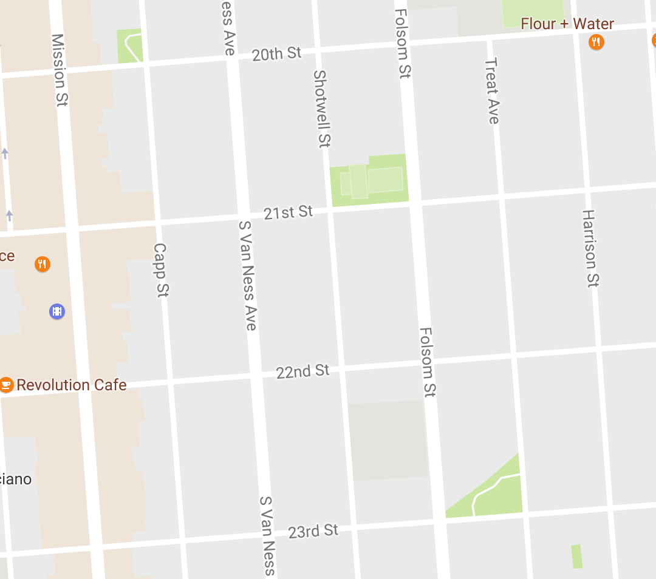
Bird’s Eye View
Karel is facing East

Slide 57
Turn Left
Karel is facing North

Slide 58
Turn Left
Karel is facing West

Slide 59
Turn Left
Karel is facing South

Slide 60
Move

Slide 61
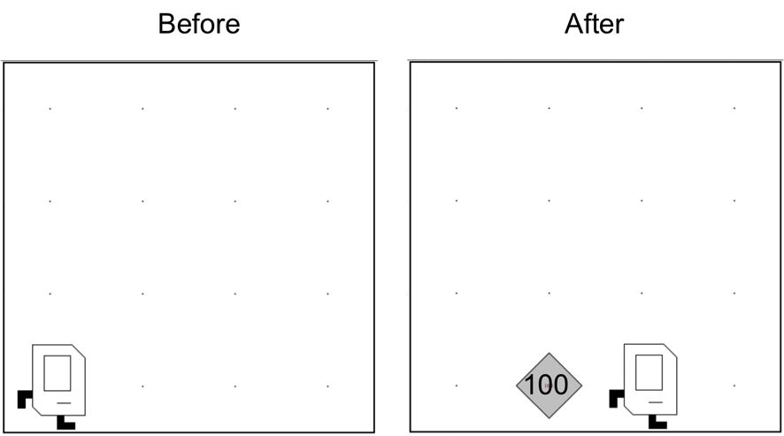
Place 100 beeper?

Slide 62

Learn By Doing

Slide 63

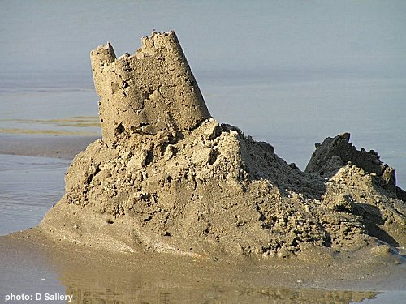
Joy of Building

Slide 64


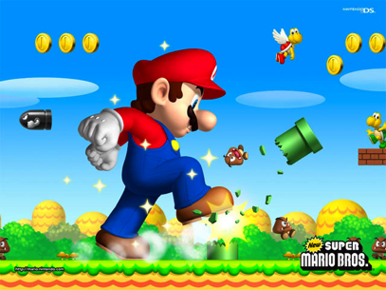

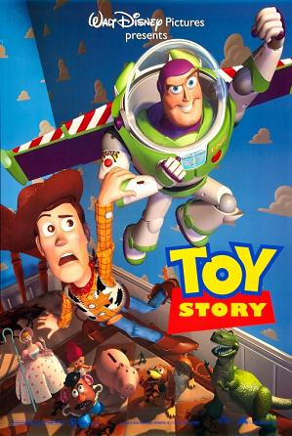
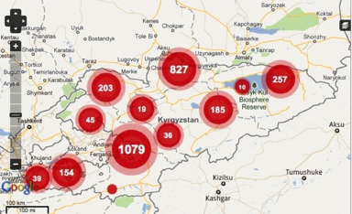
Joy of Building
Notes:
Super Mario: Japan
Angry Birds: Finland
Pixar: USA
Ushahidi: Kenya

Slide 65

Closest Thing To Magic

Slide 66
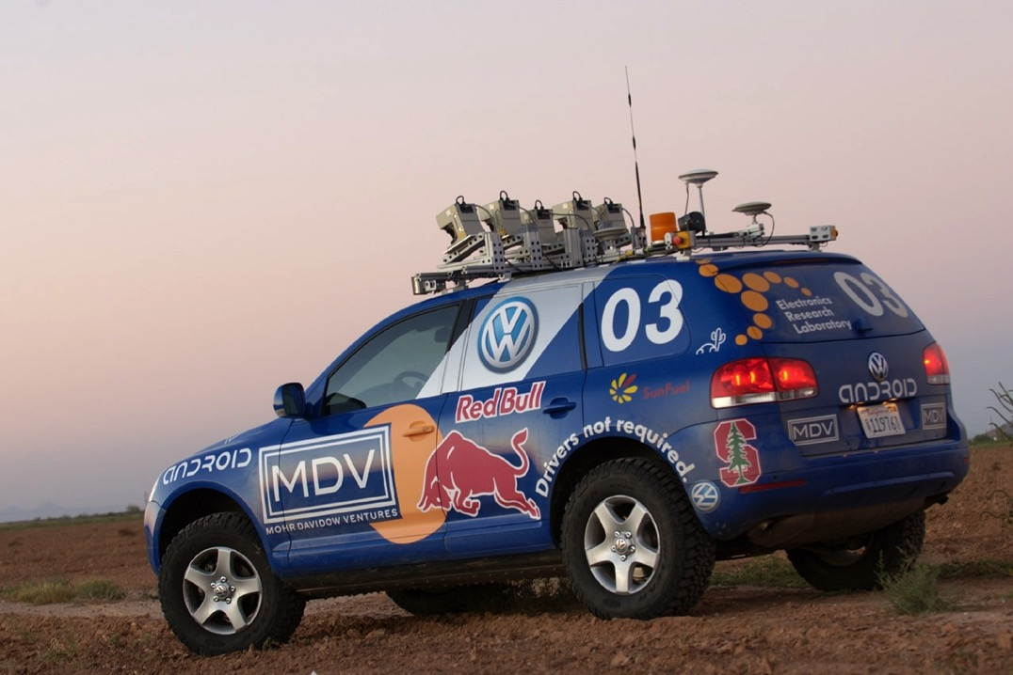
Now is the Time

Slide 67

Everyone is Welcome

Slide 68
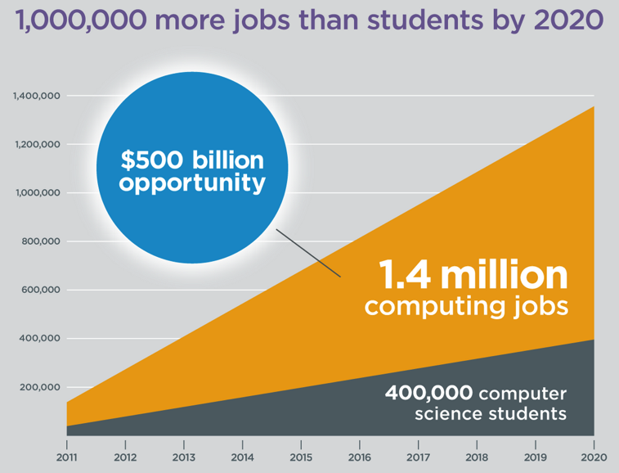
Oh and Its Useful
Code.org

